Slide 1
Video Game Analysis & Technical Design
  Ch.9 Publishers, Developers & Contracts

Slide 2
Traditional Production Flow
The Vertical Structure of the Video Game Production Process:
  The Publishers
  The Developers
  The Distributors
  The Retailers

Slide 3
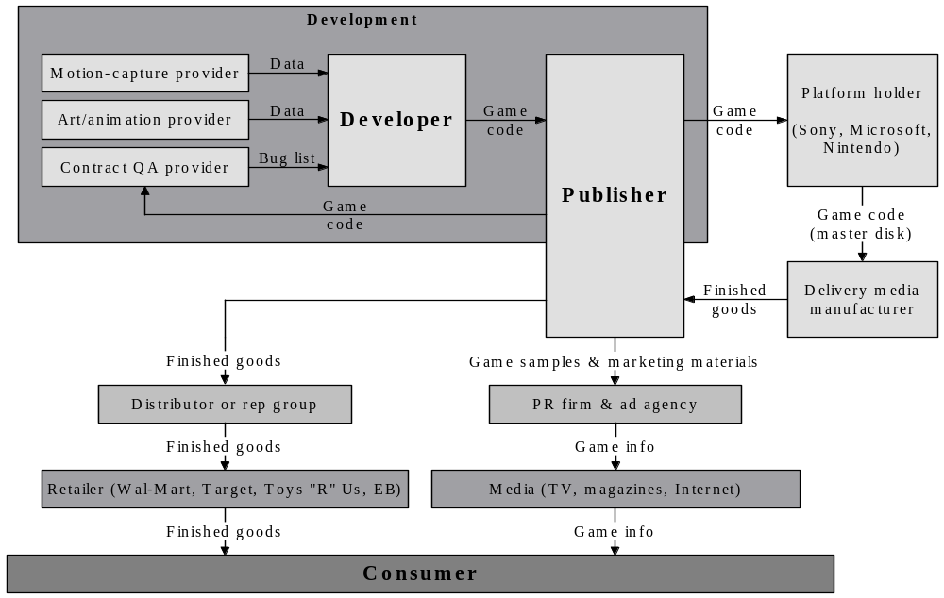
The “Players”

Slide 4
The Publisher
Publishers are the “suits” of the industry
Publishers specialize in various platforms:
  PC Only
  Console Only
  PC + Console
  Mobile
  Casual
Name a video game publisher per category…

Slide 5
What Do Publishers Do?
Publishers handle:
  The Production Process
    The publisher ensures a good product is on time.
    Manages time-to-market scheduling
  Quality Assurance
    The publisher is legally liable for the game’s quality to both consumer and platform holder.
  Licensing
    In-Game Music
    Creative Properties
    Technologies controlled by other parties
    Athletic Leagues
    Publishing under controlled platforms

Slide 6
What Do Publishers Do?
Publishers handle:
  Manufacturing and Shipping to Retail (unless online)
    Packaging
    Posters
  Sales
  Consumer Marketing
  PR
  Finances
  Investor Relations
  Legal

Slide 7
Platform Holders
Companies that manufacture hardware:
  Nintendo
  Microsoft
  Sony
  Cell Phone Providers or Manufacturers
  PDA
  Intel
  AMD
  Apple

Slide 8
What Do Platform Holder Do?
Platform holders share characteristics of:
  Owning
  Controlling
  Influencing
Provide API tools
Derive revenue from:
  Sales of Hardware
  Sales of peripherals
  Sales of their own games – “first-party games”
  Game licensing fees – “third-party games”
  Development tool kit licensing fees
  Manufacturing

Slide 9
Categories of Platforms
Open Model Platform
  Contain free APIs
  PC
  Internet
  PDA
  Cell Phone
Closed Model
  Contain proprietary APIs
  Consoles

Slide 10
Distributors
Distributors provide video games to retailers
Are the “middleman” of the industry

Slide 11
What Do Distributors Do?
Distributors provide games from the publishers to small-to-medium sized retailers.
Purchase games from publishers and resell to smaller independent stores and chains
Compete on:
  Price
  Speed
  Availability
Earn profit margin of around 3%
Work on volume sales

Slide 12
Retailers
Retailers provide games to the end-user
Typically follow the brick-and-mortar model
Retailers generally earn 30% margin on a $50 game
Brick-and-Mortar Model
  A business model requiring a physical location
  Pros:
    Opportunity to work face-to-face with customers
    Physical location may attract walk-in traffic
  Cons:
    Higher start-up risks
    Requires full-time commitment
    Must acquire inventory

Slide 13
What Do Retailers Do?
Several types of retailers:
  Regional Retailers
  Rental Retailers
  National Retailers
  E-Retailers

Slide 14
Regional Retailers
Independent store chains with in-depth consumer sales relationships
Compete on product knowledge and differentiated product offering
Buy games from distributors

Slide 15
Rental Retailers
Purchase games from publishers at standard pricing, but with no returns
Allows consumer to try a game before buying
  Boosts sales of good games…
  Kills bad ones!
Some rental retailers have begun selling games

Slide 16
National Retailers
Familiar names:
  Electronic Boutique
  Best Buy/Future Shop
  Toys “R” Us
  Wal-Mart
Publisher bears burden of relationship:
  Ships games to distribution center or directly to stores
  Provides in-store merchandising materials
  Provides store staff with sales materials
  Generous payment terms
  Inventory auditing
  In-store promotional events

Slide 17
National Retailers
Retail buyer makes all game purchasing decisions
  Indifferent buyer = poor sales and disorganized in-store selection
Buyers hold various controls:
  Not stock a game at all
  Stock only in best-performing stores
  Feature game in weekend circulars
  Pricing adjustments

Slide 18
E-Retailers
Sales of packaged goods by Internet retailers
Electronic download of games via Internet still in infancy

Slide 19
Who Are Developers?
Developers:
  Design & Implement the video game
  Duties include:
    Programming
    Art
    Sound Effects
    Music
  May exist as part of a Publisher
  Developers may outsource development components
  We are developers!

Slide 20
Development Teams in the 1980s
In the 1980s, video game development teams ranged in size, from:
  1 – 2 Designer/Producer/Programmer/Artist/
  Musician – The jack of all trades!
  Development time ranged from 3 to 12 months

Slide 21
Development Teams in the 1990s
In the 1990s, video game development teams ranged in size, from:
  6 – 10 individuals:
    1 Designer
    5 Programmers
    1 Artist
    2 Level Designers
    1 Musician
  Development time for AAA titles ranged from 15 – 18 months

Slide 22
Development Teams in the New Millennium
Currently, video game development teams ranged in size, from:
  20 – 60 individuals:
    Executive Management
    Programming Departments
    Artistic Departments
    Music/Audio Departments
    Testing Departments
    3rd Party Development
  Development time for AAA titles ranged from 24 – 48 months
Smaller development teams (and timelines) common for mobile, social and casual games!

Slide 23
Title Classification
Due to the flux in team sizes, games have been classified as:
  AAA titles:
    Highest Production Value – Big Team Sizes
    Highest Budget
    Best Seller
  A titles:
    Major Releases
    High Production Value – Big Team Sizes
    High Budget
    High Marketing
  B titles:
    Less Glamorous Production Value – Medium Team Sizes
    Medium Budgets
  C titles:
    Low Production Value – Small Team Sizes
    Cheap

Slide 24
Indie Game Development and the
Rise of Internet Distribution
Retail chains and AAA distribution mechanisms are disappearing…..fast.
  In the 1990s, if you wanted to make a game, you had to knock on the door of a AAA publisher (such as EA) and say “I’ve got a great game idea!” To which they would reply “Get lost kid, we’ve got our own ideas.”
  That all changed in the past decade.
  Today, anyone who knows programming and a bit of art (or has an artistic friend) can create a game on their own – the game they WANT to make – and publish via a plethora of different online marketplaces such as Steam, Apple App Store, Android Play Store, and so on….
As a result, we now see more games than ever before of different types and genres.
Games such as Super Meat Boy, Fez, Angry Birds, or Minecraft would not have been
possible 10 years ago because a AAA publisher wouldn’t OK the project and likely
would not be driven to put in the same great gameplay features.
In short, the indie game movement is shaping the game industry faster than any other
factor, and scaring larger AAA publishers. Larger game studios now recruit almost
exclusively from the indie game developer community and game jam events. A good
example of this is Ubisoft, who is well known for recruiting from Global Game Jam in
downtown Toronto at the Ryerson DMZ (where most of the participants are triOS
students ;-)
But the indie game movement wouldn’t have been possible if it weren’t for Internetbased
game distribution…..which cut out the following traditional roles almost entirely:
• Distributors
• Retailers
Gabe Newell, one of the founders of Valve Corporation (creator of Steam) once said that
Walmart was the biggest reason games never went online. If a publisher wanted to do
online distribution, Walmart threatened to pull all stock of that game from their shelves
(remember that Walmart was a big game retailer). Valve had no ties to Walmart, and so
showed people and publishers that Internet-based distribution is the way of the future.

Slide 25
Indie Game Development and the
Rise of Internet Distribution
As a result, we now see more games than ever before of different types and genres.
  Games such as Super Meat Boy, Fez, Angry Birds, or Minecraft would not have been possible 10 years ago because a AAA publisher wouldn’t OK the project and likely would not be driven to put in the same great gameplay features.
  In short, the indie game movement is shaping the game industry faster than any other factor, and scaring larger AAA publishers. Larger game studios now recruit almost exclusively from the indie game developer community and game jam events.

Slide 26
Indie Game Development and the
Rise of Internet Distribution
  A good example of this is Ubisoft, who is well known for recruiting from Global Game Jam in downtown Toronto at the Ryerson DMZ (where most of the participants are triOS students ;-)
But the indie game movement wouldn’t have been possible if it weren’t for Internet-based game distribution…..which cut out the following traditional roles almost entirely:
  Distributors
  Retailers

Slide 27
Indie Game Development and the
Rise of Internet Distribution
Gabe Newell, one of the founders of Valve Corporation (creator of Steam) once said that Walmart was the biggest reason games never went online.
  If a publisher wanted to do online distribution, Walmart threatened to pull all stock of that game from their shelves (remember that Walmart was a big game retailer).
  Valve had no ties to Walmart, and so showed people and publishers that Internet-based distribution is the way of the future.

Slide 28
Indie Game Development and the
Rise of Internet Distribution
Internet-based game distribution continues to rise (and will continue to rise with the introduction of the PS4 and Xbox One).
  So what does this mean for production flow and the game industry in general? In short, it means that:
    The distributor and retailer are now online. They still take a cut of sales, but it is usually a smaller cut, and they provide more services (related to the hosting and downloading of the game).
    Publishers are now focused on dealing with production of the game and the legal agreements and publishing requirements of the online retailer.
    Cross platform game creation is becoming more important (more monetization).

Slide 29
Indie Game Development and the
Rise of Internet Distribution
    Cross platform game engines such as Unity are becoming very popular as a result.
    There are more smaller game studios and independent game developers than ever before. The biggest challenge for these game developers is the promotion of their game in a bigger marketplace (social media promotion is key to this as discussed later in Chapter 12).
    Larger game studios are spending more time working with online distributors than ever before.
    Focus is now placed on the creative process of game creation – get the game done and published as fast as possible.
To learn more about the indie game movement, watch the documentary Indie Game: The Movie (2012). It is available on Steam, and will be shown in your class by your instructor.

Slide 30
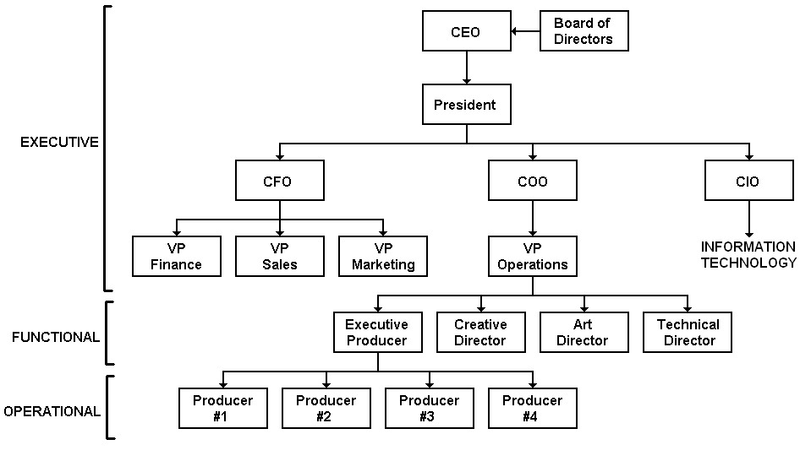
Management Teams
The bosses of your future bosses have three levels of management.

Slide 31
Executive Management
Executive Management is responsible for:
  Setting up a strategy and definition for the company
  EA has 13 Executive Managers
Executive staff has the following positions:
  Chief Executive Officer (CEO)
  Board of Directors
  President
  Chief Financial Officer (CFO)
  Chief Operating Officer (COO)
  Chief Information Officer (CIO)
  Vice Presidents

Slide 32
The Chiefs
CEO’s responsibilities are:
  Ensure proper company operations
  Set strategic plans for the company
CFO’s responsibilities are:
  Set the financial plans for the company
  Ensures money is available for a project
  Authorizes expenses
  Develops economic strategies and financial forecasts
  Analyzes financial risk
COO’s responsibilities are:
  Oversees day-to-day company operations
  Purchases necessary equipment
  Ensures proper staff is hired and schedules are maintained
CIO’s responsibilities are:
  Ensures adequate hardware and software infrastructure

Slide 33
The Board of Directors
The Board of Directors is a group of individuals elected by stockholders for publicly held companies
The act as advisors to the company
Make suggestions about new directions the company will take

Slide 34
President
The President is the leader of the company
Ensures stock holders receive ROI
Often approves games for development

Slide 35
The VPs
Vice Presidents oversee individual development departments
Ensure the project is on schedule
Approves departmental decisions for a project

Slide 36
Functional Management
Functional Management is responsible for:
  Project specialists
  Typically there are positions per project
Functional staff has the following positions:
  Executive Producer
  Creative Director
  Art Director
  Technical Director

Slide 37
Functional Management
Executive Producers are responsible for:
  Listening to projects pitches
  Determine which games will be developed
  Oversee the overall project brands
Creative Directors are responsible for:
  Helping and guiding design teams update documentation
  Approves final design features of a game
Art Directors are responsible for:
  Define the overall graphic look of the project
  Supervises art leads
  Helps develop art design documents
Technical Director
  Define the overall architecture of the project
  Supervise Tech leads
  Help develop technical design documents

Slide 38
Operational Management
Operational Management is responsible for:
  Documenting project elements
  Supervising departmental staff
Operational staff has the following positions:
  Producer or Project Manager

Slide 39
Producer
The Producer is the Project Manager
  Determines the initial design
  Develops the initial budget and schedules
  Updates project timelines
  Oversees builds at each milestone
  Presents projects to management
  Manages Programming, Art, Audio/Music and Testing departments

Slide 40

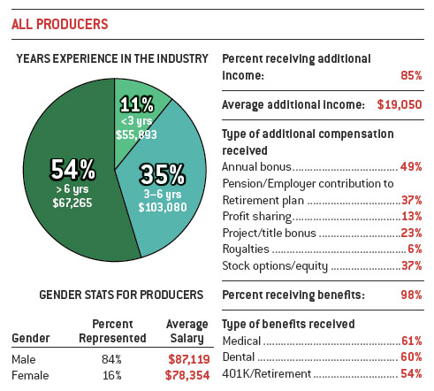
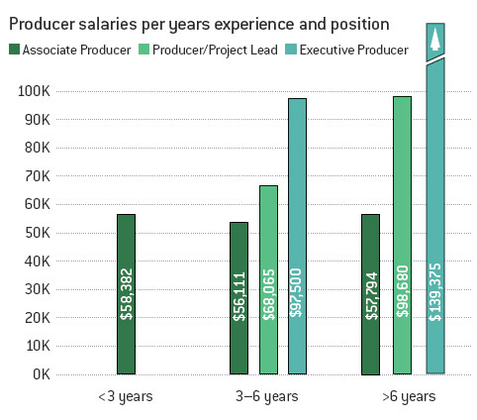
Producer

Slide 41
Designer
Designers are responsible for developing the game idea and documentation
Roles include:
  Senior Designer
    In charge of overall game design
    Works with people from several teams
  Assistant Designer
    Involved in the details of creating the game
  Level Designer
    Builds 3D playing fields

Slide 42
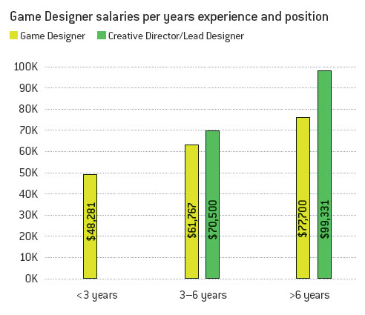
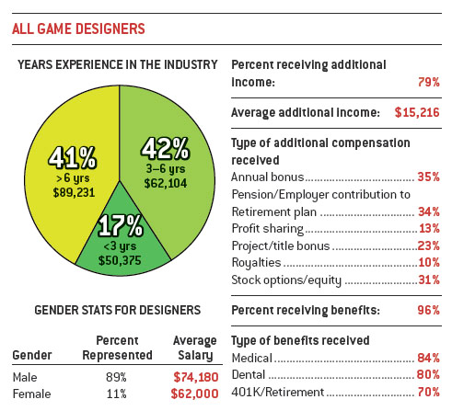
Designer

Slide 43
Programmer
The Programming division are small teams that are responsible for all the programming aspects of a video game
Roles Include:
  Lead Programmer
    More advisory than hands-on coding
    Creates timelines
    Interviews programming applicants
  Game Engine Programmer
    Create game engine from scratch
    Adapt an existing game engine
  Tools Programmer
    Develops tools needed to create the game
  AI Programmer
    Writes code for artificial intelligence routines

Slide 44
Programmer
Roles Include:
  Graphical User Interface (GUI)
    How the player interacts with the game
    Screen (Fills the entire monitor)
    Window (Pop-up display)
    Menu (List of options)
  Interface Programmer
    Develops the Graphical User Interface (GUI)
    Writes code for menus
  Networking Programmer
    Writes code to allow the game to function over the Internet
  Audio Programmer
    Creates tools to store and play sound
  Quality Assurance Programmer
    Tracks and removes bugs from the game

Slide 45
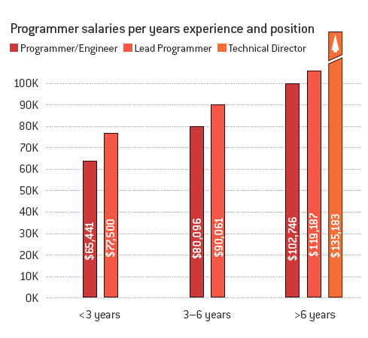
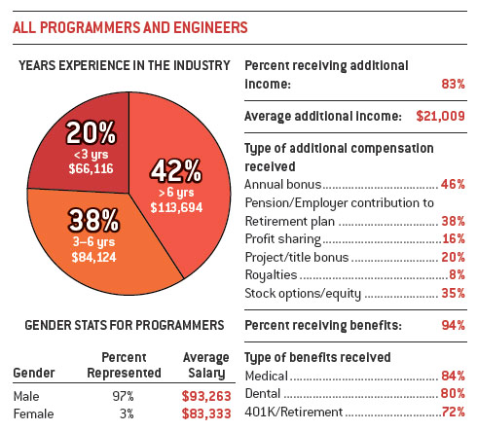
Programmer

Slide 46
Art
The Art division are teams that are responsible for the artistic aspects of a video game
Roles include:
  Lead Artist
    Responsible for art being completed on time
    Interviews new hires
  2D Artist
    Draw items in perspective
    Uses traditional art tools
  Interface Artist
    Works on control combinations
    Artwork for icons and backgrounds
  3D Modeler
    Create 3D meshes from 2D polygons

Slide 47
Art
Roles include:
  3D Animator
    Makes sure 3D images move correctly
  3D Texture Artist
    Create the textures or “skins” of 3D objects
  3D Environment Modelers
    Create terrain features (trees, plants, buildings)
  Full-Motion Video (FMV) Artists
    Create animated sequences used in the game

Slide 48
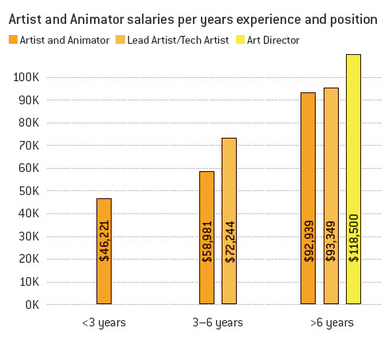
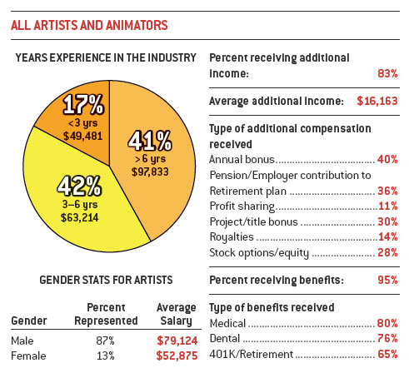
Art

Slide 49
Audio/Music
The Music division is responsible for finalizing scores, sound effects and designs comprised in the video game
Roles include:
  Composer
    Composes music for the game
  Audio Technician
    Creates all the sound effects for the game

Slide 50
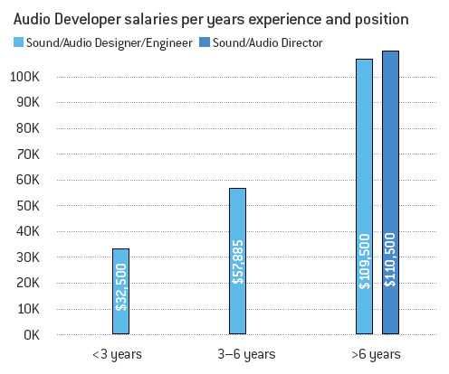
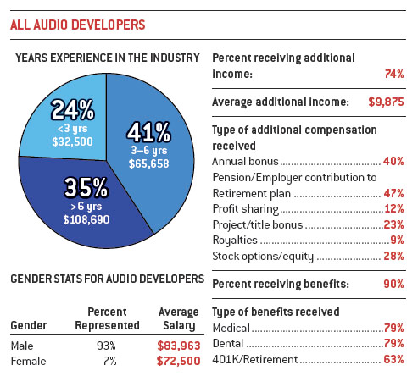
Audio/Music

Slide 51
Testing/Quality Assurance
The Testing and Quality Assurance division is responsible for testing and ensuring the game is playable
Roles include:
  Quality Testing (Assurance) and Playtesting
    Quality Assurance Lead
      Makes sure bugs are reported and fixed
    Quality Assurance Technician
      Provides feedback about game play
    Playtester
      Tests game as thoroughly as possible

Slide 52
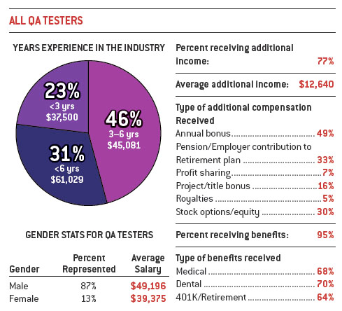
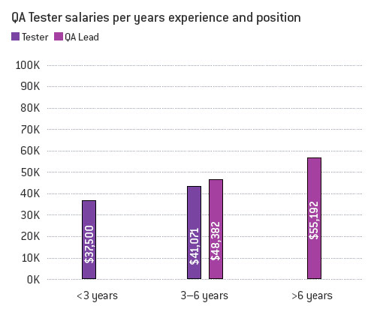
Testing/Quality Assurance

Slide 53
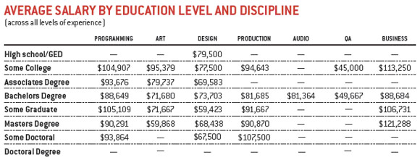
Education doesn’t matter – what you can DO does!

Slide 54
3rd Party Companies
3rd party companies are appointed for special duties that development companies cannot manage:
  Motion Capture Technicians
    Assist in creating smooth animation
  Dialogue Writer
    Screenwriter who polishes a character’s dialogue
  Audio and Visual Director
    Works with actors
  Manual Writer
    Creates manual to describe game and game play
  Compatibility testing
    Tests game on different hardware configurations
  Localization
    Translates game into different languages

Slide 55
Contract Basics
Video game contracts are relatively complex
  Employer and employee typically have bargaining power
  i.e. Video game employment contracts are different from contracts of other nature:
    A subway transfer is a contract with no bargaining power
    Purchasing a coffee from Starbucks is a contract where you buy it, they make it

Slide 56
Verbal and Written Contracts
Contracts must always be written
  Almost any contract is binding – oral or written
  Oral contracts might not hold in court if hard to prove

Slide 57
What is Consideration
Consideration:
  An exchange of value between the parties
  In the video game industry, consideration rarely comes into play

Slide 58
Contract Terms
Advances
  Advances are payments made from employer to employee before a product is complete
  Typically occurs between publisher and developer
    The developer forfeits royalties until advances are fulfilled

Slide 59
Contract Terms
Cross-Centralization
  Warrants an employer to recover advances through other projects
  Typically occurs between publisher and developer
    The developer provides advance compensation through completion of multiple projects

Slide 60
Contract Terms
Gross
  The summed profit of each unit of a product sold
Net
  The total profit made from each unit of a product sold

Slide 61
Contract Terms
Assignment
  Complete transfer of contractual rights to a third party
Sublicensing
  Final responsibility of contractual rights with other primary parties

Slide 62
Contract Terms
Termination
  A termination of contract before completion of a project
Breach of Contract
  Failure to perform obligations within a contract, unless legally excused from performance
    Material Breach
      Breach of essential elements of a contract
    Immaterial Breach
      Violation of a term of the contract that does not prevent the contract from moving forward

Slide 63
Contract Terms
Indemnification
  Agreements protecting trade secret
    i.e. Exposure of a video game engine with a publisher
  Discloses third-party developer technology to be used in the project

Slide 64
Contract Terms
Venue Jurisdiction
  Dictates a region where an employer’s clause is protected by law
Arbitration
  A method of resolving disputes between parties by appointing an impartial individual or group to judge the differences at issue between the parties and issue a decision. The decision in arbitration can be legally binding if both parties have agreed to it before the decision is made
Equitable Relief
  Relief not concerned with money damages
    i.e. Could be in the form of an injunction

Slide 65
NDA
Non-Disclosure Agreements
  Used to protect trade secret
  Withhold employees from sharing information about a specific subject
  Can extend beyond period of employement

Slide 66
Employment Contracts
Two types of employment contracts:
  “At-Will” Contracts
  Independent Contracts

Slide 67
Employment Contracts
“At-Will” Contracts
  Typically Assigned to Full-Time or Part-Time Employees
    Salary Based
    Benefits
    Establishes
      Duties
      Salary
      Confidentiality Agreements
      Non-Competition
      Conditions for Termination
    Employees are free to quit “at will”
    Employers must tax employees

Slide 68
Employment Contracts
Non-Competition
  Prevents employees from working with competition
  Requires strict compliance with laws
  Varies based on country

Slide 69
Employment Contracts
Independent Contracts
  Freelance contracts
  Fixed payments
  No salary or benefits
  Employers do not tax
  Once assigned duties are complete employee’s contract expires
  Employees must have tools
  Typically IP belongs to employer

Slide 70
Licensing & Assignment
Licensing
  The right to use someone's IP
  Applies to
    Game Engines
    Game Consoles
    Development Kits
Assignment
  Conveys entire IP to another person
  Applies to
    Modifying Game Engines

Slide 71
End-User License Agreements (EULA)
EULA
  Licenses between publisher/developer and user
  Prevents players from coping games
  Game Modification License Agreements
    i.e. Counter Strike
    Belongs to publisher/developer

Slide 72
Publisher and Developer Contracts
Payments
  Calculated on milestone submissions
Royalties
  Percentage of sales after recouped advances
Expenses
  Agreements on marketing and manufacturing costs

Slide 73
Publisher and Developer Contracts
Milestones
  Process in which developer submits deliverable for review by the publisher
  Typically agreements made on:
    What are milestones submitted
    What do the milestones consist of
    How long will milestones be tested for compliance
    How long does the publisher take to approve or deny
    Who is responsible for approving or denying
    How much time is allowed for corrections
    What is the process of correction
    How long after a approval is a milestone paid

